Slide 1
Face position and angle estimation
Carlos Emiliano Solórzano Espíndola

Slide 2
Introduction
The present works propose a method for face detection using color features.
The method aims to detect the relative position and the angle of the face with respect to the camera.
The result is a normalized image containing just the face and in the reoriented angle.

Slide 3
algorithm
Image
Normalization
Skin Detection
Geometric Estimation
New Image
Thresholding

Slide 4
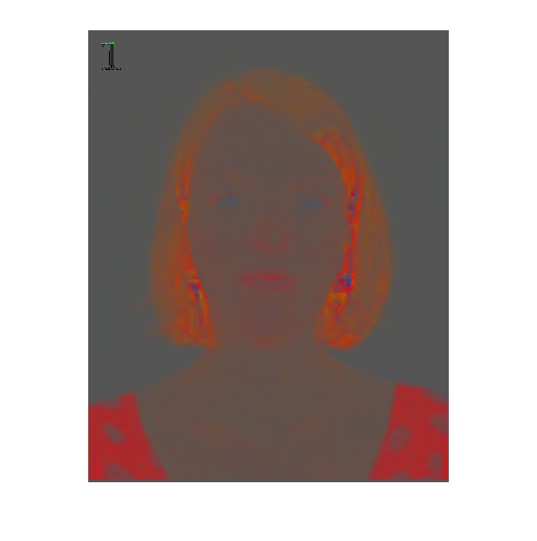
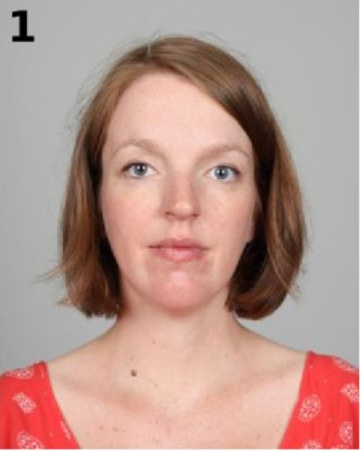
Normalization
Reduces illumination efects on the image.

Slide 5
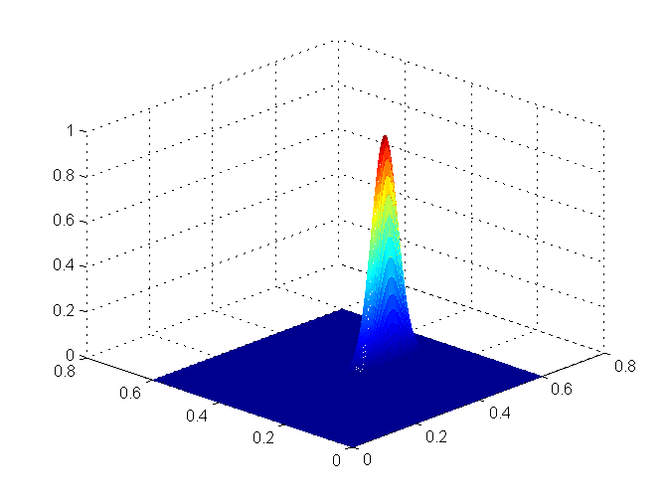
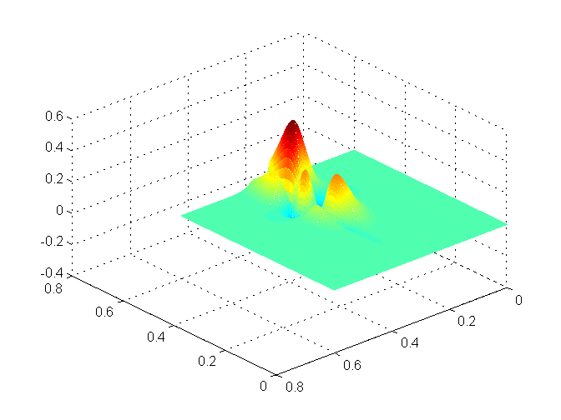
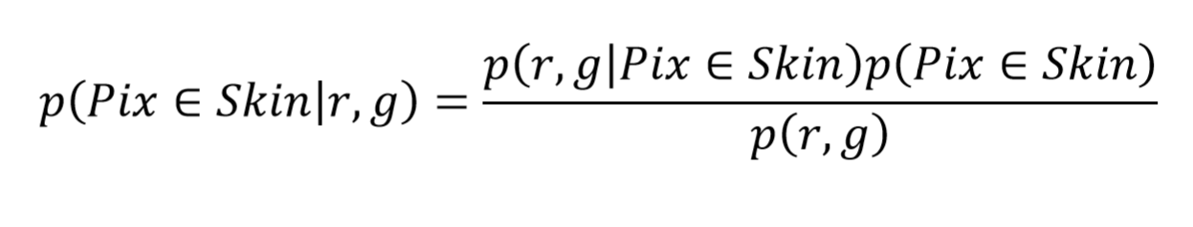
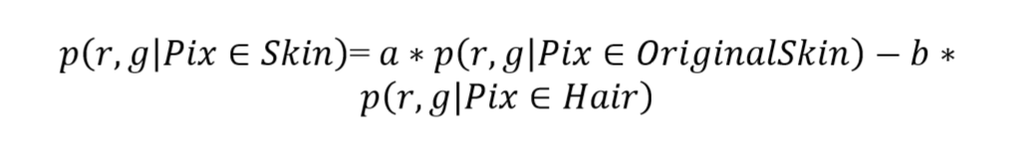
Segmentation
Probability of a pixel to be skin given their r and g values.

Slide 6
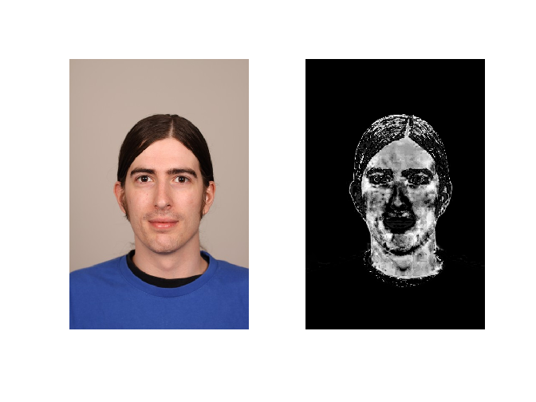
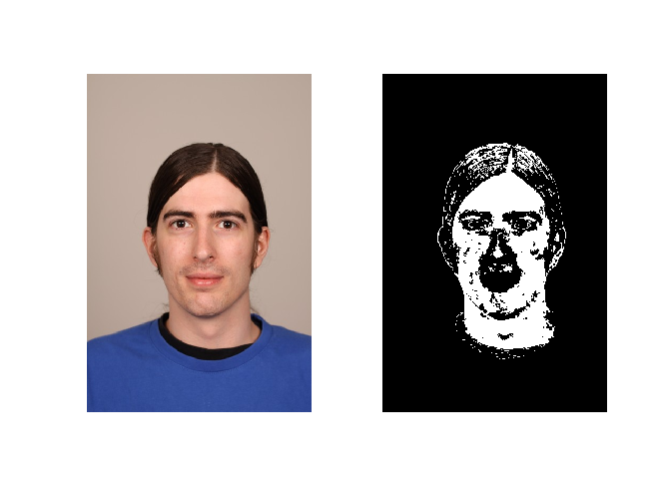
Threshold
Minimum value to be considered skin.
Varies depending on the samples used for the training.

Slide 7
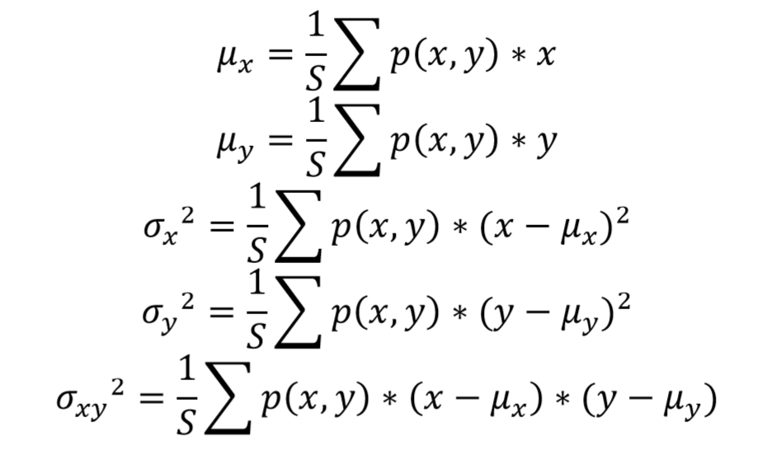
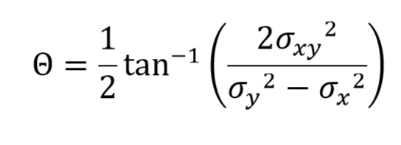
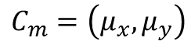
Position and Angle Estimation
$$C_{m}=\left(μ_{x},μ_{y}\right)$$

Slide 8
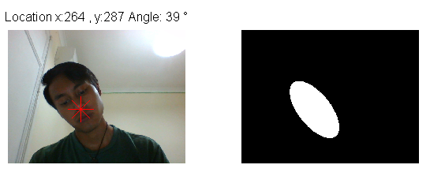
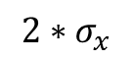
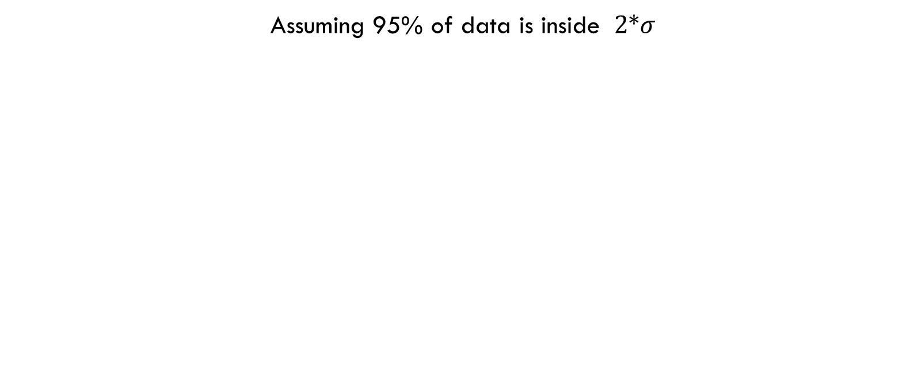
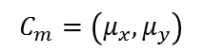
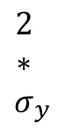
New Image Creation
Assuming 95% of data is inside $\text{2*}σ$
$${\begin{aligned}2 \\ ∗ \\ σ\end{aligned}}_{y}$$
$${2∗σ}_{x}$$
$$C_{m}=\left(μ_{x},μ_{y}\right)$$

Slide 9
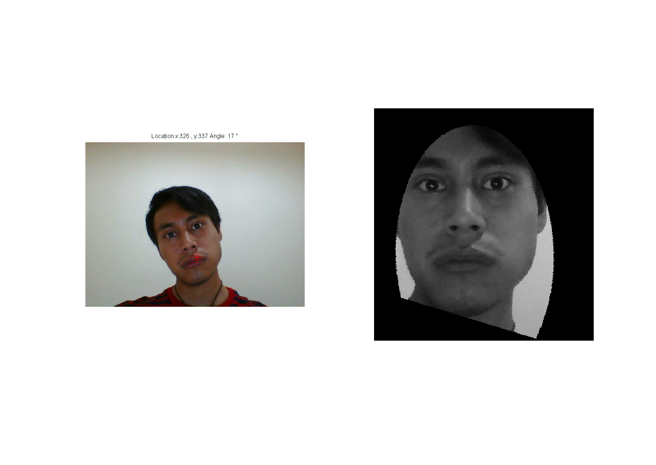
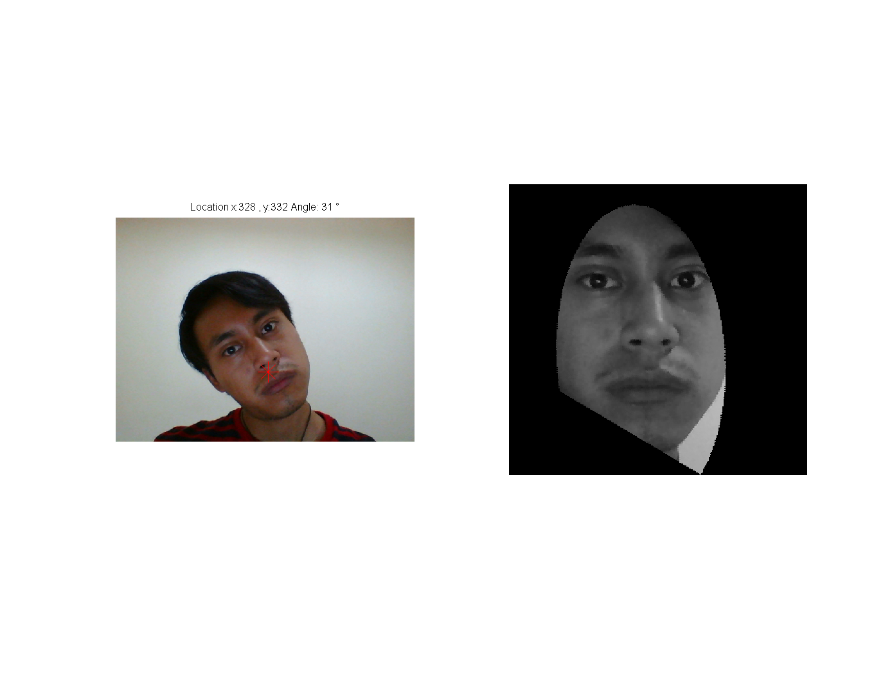
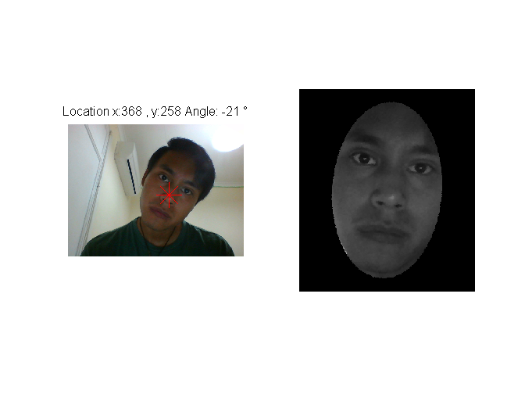

Slide 10
